Slide 1
The diffusion equation

Slide 2
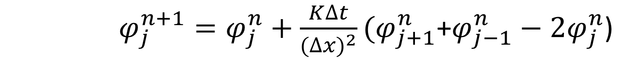

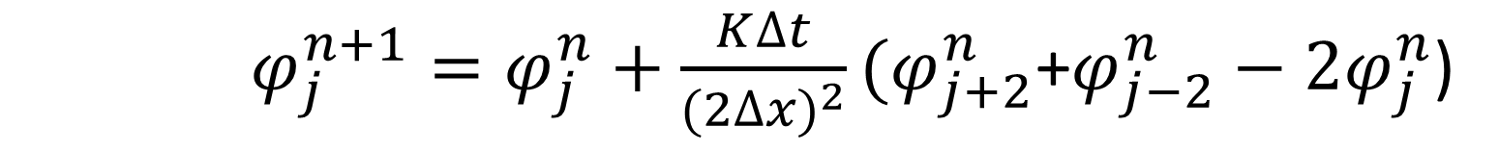
$$\frac{∂u}{∂t}=K\frac{∂^{2}u}{{∂t}^{2}}$$
FTCS compact
$φ_{j}^{n+1}=φ_{j}^{n}+\frac{K∆t}{{(∆x)}^{2}}(φ_{j+1}^{n}$+$φ_{j−1}^{n}−2φ_{j}^{n}$)
FTCS non-compact
$φ_{j}^{n+1}=φ_{j}^{n}+\frac{K∆t}{{(2∆x)}^{2}}(φ_{j+2}^{n}$+$φ_{j−2}^{n}−2φ_{j}^{n}$)

Slide 3
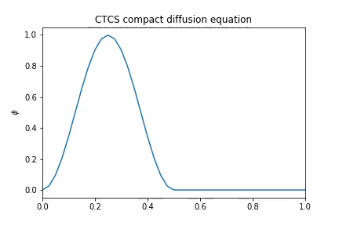
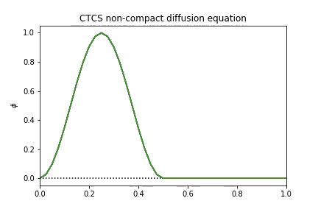

Slide 4
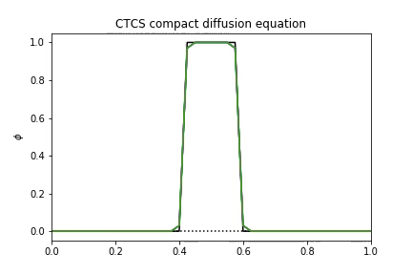
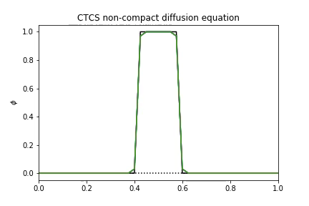

Slide 5
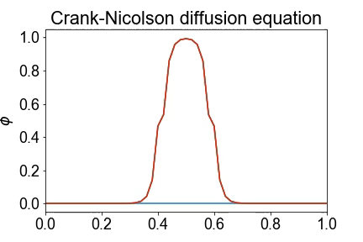
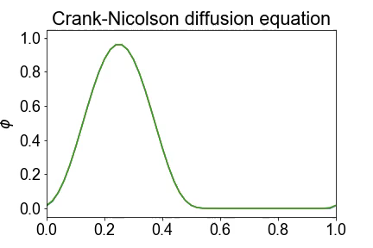

Slide 6
